Slide 1
EIFL webinar: Services for authors
Romy Beard
Licensing Programme Manager
5 October 2021

Slide 2
Agenda
Waived and discounted open access publishing fees
Free use of scite
Discounted editing services from Enago

Slide 3
1. EIFL agreements for discounted and waived APCs
Website: https://eifl.net/apcs, search by country
11 agreements in place
APC waivers and APC discounts
Over 2,500 journals in total
Reputable publishers

Slide 4
EIFL website

Slide 5
Details of agreements

Slide 6
How to claim waivers

Slide 7
Webinars with detailed instructions for some publishers

Slide 8
Link to country specific title list

Slide 9
Example: title list for Zambia
Please always use this link!
https://www.eifl.net/zambia_apcs

Slide 10
Options

Slide 11
Search by keyword

Slide 12
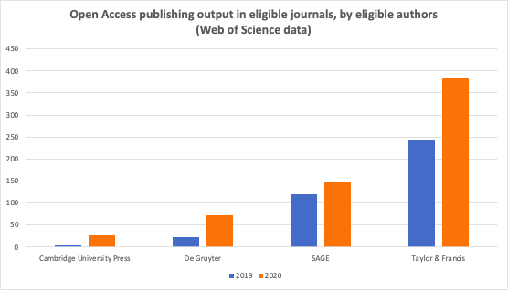
62% increase in OA output due to EIFL agreements
https://eifl.net/blogs/eifl-agreements-result-increased-oa-publishing

Slide 13
2. Scite agreements with EIFL
https://eifl.net/technology/scite
Free to use for researchers subject to libraries signing up
COUNTRIES ELIGIBLE FOR FREE ACCESS: Congo, Ethiopia, Kenya, Kyrgyzstan, Lesotho, Malawi, Myanmar, Senegal, Sudan, Tanzania, Uganda, Uzbekistan, Zambia, Zimbabwe
COUNTRIES ELIGIBLE FOR DISCOUNTED ACCESS: Albania, Armenia, Belarus, Botswana, Estonia, Fiji, Georgia, Ghana, Ivory Coast, Kosovo, Laos, Latvia, Lithuania, North Macedonia, Maldives, Moldova, Namibia, Palestine, Serbia, Slovenia, Thailand, Ukraine

Slide 14
Scite demo: How can researchers use scite to improve their articles?

Slide 15
Forthcoming Scite webinar
EIFL webinar: Scite product demo for researchers & librarians
Date: Monday 18th Oct
Time: 2pm GMT / 3pm CET - check your timezone here: https://www.timeanddate.com/worldclock/fixedtime.html?msg=EIFL+webinar%3A+scite+product+demo&iso=20211018T14&p1=136&ah=1
Registration link: https://us02web.zoom.us/webinar/register/WN_vL7L_OaNTX-8CvIHuoyPUQ
In this product demonstration, scite co-founder and CEO Josh Nicholson will take us through different scenarios of how scite can be used by researchers to improve their papers and help with research literature, and how librarians can use scite for analytical purposes.

Slide 16
3. Discounted editing services for authors via Enago
https://www.eifl.net/technology/enago
EIFL has negotiated discounted pricing for authors from Zambia for Enago’s Copyediting and Substantive Editing Services.
Copyediting: $0.040 / word
Substantive Editing: $0.060 / word
Quote request via the EIFL Enago landing page: https://www.enago.com/assoc/eifl/
Eligible countries: Albania, Armenia, Belarus, Botswana, Congo, Estonia, Ethiopia, Fiji, Ghana, Ivory Coast, Kenya, Kosovo, Laos, Latvia, Lesotho, North Macedonia, Malawi, Maldives, Moldova, Myanmar, Namibia, Nepal, Palestine, Senegal, Serbia, Slovenia, Sudan, Tanzania, Uganda, Ukraine, Zambia, Zimbabwe

Slide 17
Enago demo How can articles be improved by an editing service?

Slide 18
Thanks!
Romy Beard
EIFL Licensing Programme Manager
Romy.beard@eifl.net

