Slide 1



Lucy Barnes
Editor and Outreach Co-ordinator

Slide 2


Open Book Publishers
World-leading independent Open Access book publisher
Not-for-profit
Run by academics
All books rigorously peer-reviewed
No charge for authors to publish

Slide 3

Today’s webinar
OBP’s Library Membership Programme:
more access to our books for EIFL libraries
Our books:
multiple editions, reader numbers,
global research
The future of Open Access books:
ScholarLed and COPIM
Photo by Jason Rosewell on Unsplash

Slide 4


EIFL and OBP: working together
OBP Library Membership Programme
Free for EIFL libraries in non-OECD countries
1058 libraries included so far
Armenia
Azerbaijan
Belarus
Botswana
Cambodia
Congo
Ethiopia
Fiji
Georgia
Ghana
Ivory Coast
Kenya
Kosovo
Kyrgyzstan
Laos
Lesotho
Macedonia
Malawi
Maldives
Moldova
Myanmar
Namibia
Nepal
Palestine
Senegal
Sudan
Tanzania
Thailand
Uganda
Ukraine
Uzbekistan
Zambia
  Zimbabwe
Photo by Ed Robertson on Unsplash

Slide 5

More access to our books!
Free access to our entire range of ebooks
Discounts on our paperback and hardback editions
  20% for library purchases
  15% for individual purchases from the library network
Your library’s usage statistics
MARC records for all our books

Slide 6

The traditional model
Average monograph:
will sell 200-400 copies in its lifetime
Priced at £80 - £120:
mostly bought by university libraries
Logistics:
physical copies must be delivered
Photo by Ula Kuźma on Unsplash

Slide 7
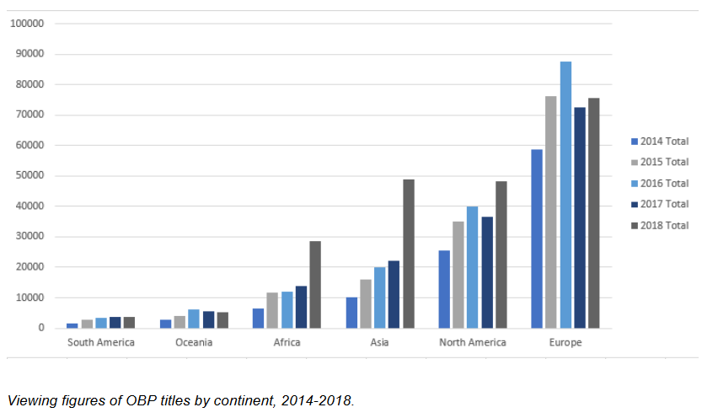
Open Access: more readers
Each of our books is viewed, on average, 400 times in a single month
Our books never go out of print
Available everywhere with an internet connection: more equitable, more convenient
Accessible on multiple platforms:
  OBP website
  Directory of Open Access Books (DOAB)
  The OAPEN Library
  OpenEdition
  Worldreader
  Google Books

Slide 8
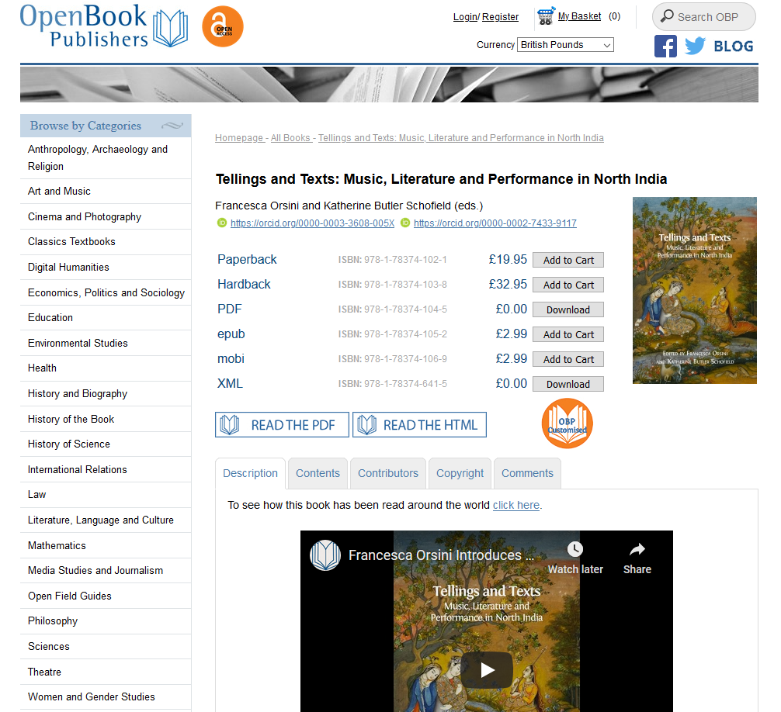

Slide 9
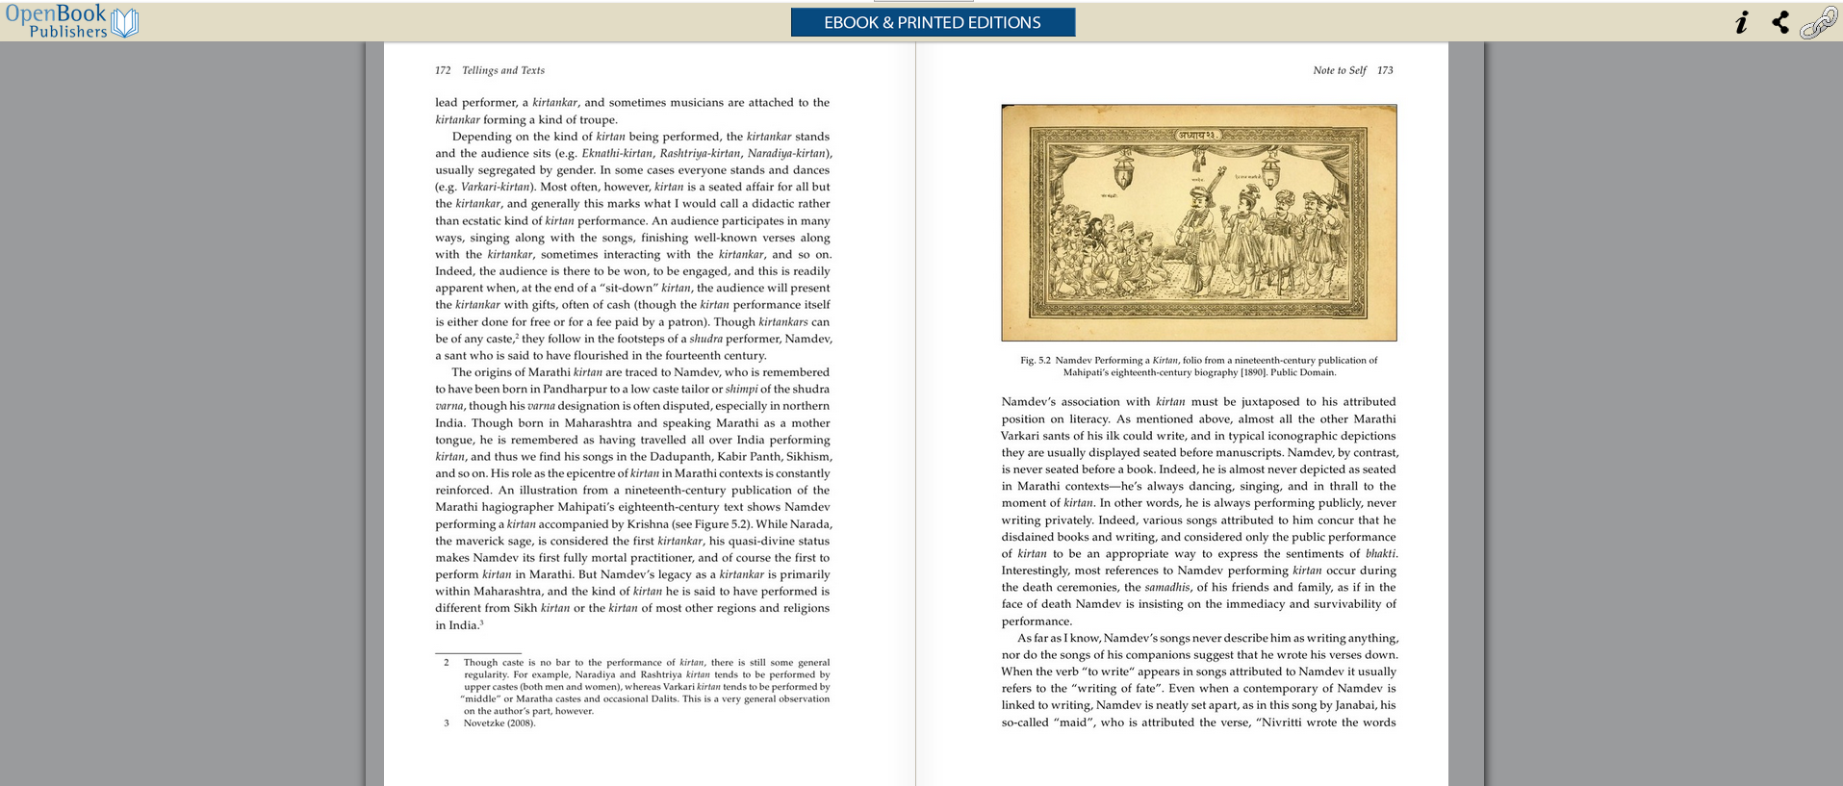

Slide 10
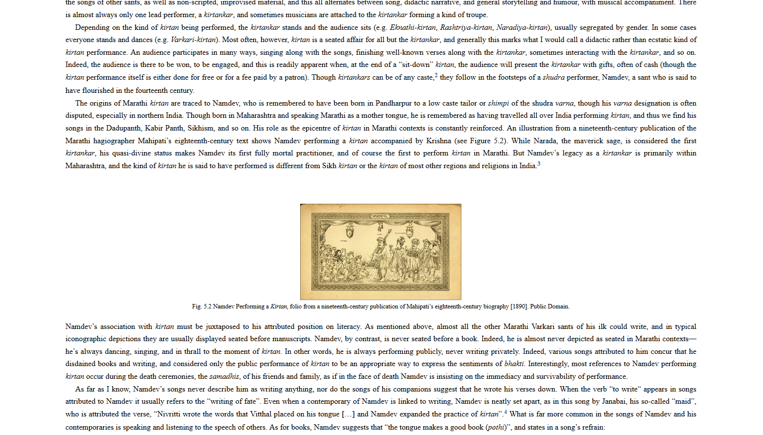

Slide 11
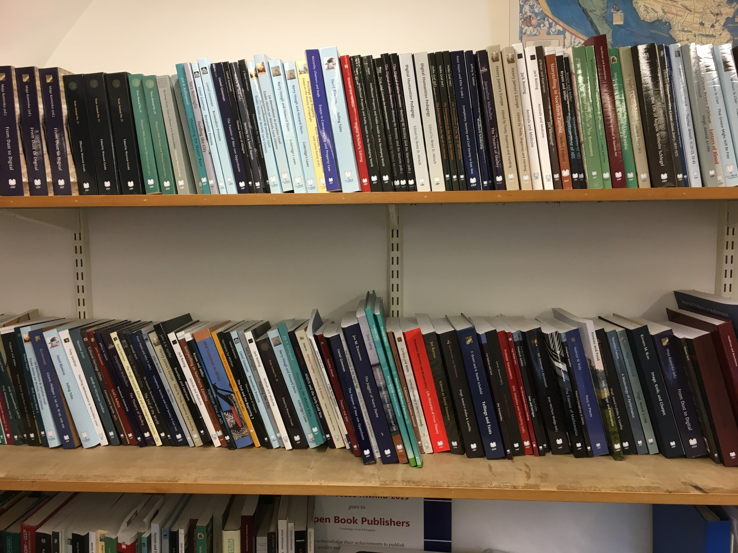
Physical books as well as digital!
Paperbacks & hardbacks:
£15 (PB) & £30 (HB)
Free digital editions:
PDF, HTML and XML
Paid-for digital editions:
EPUB and MOBI (£5.99)

Slide 12










A global perspective

Slide 13

Innovative publications
Embedded audio and video
Commentary and text analysis
Zooming function
Digital platform → printed book
Photo by Ross Findon on Unsplash

Slide 14
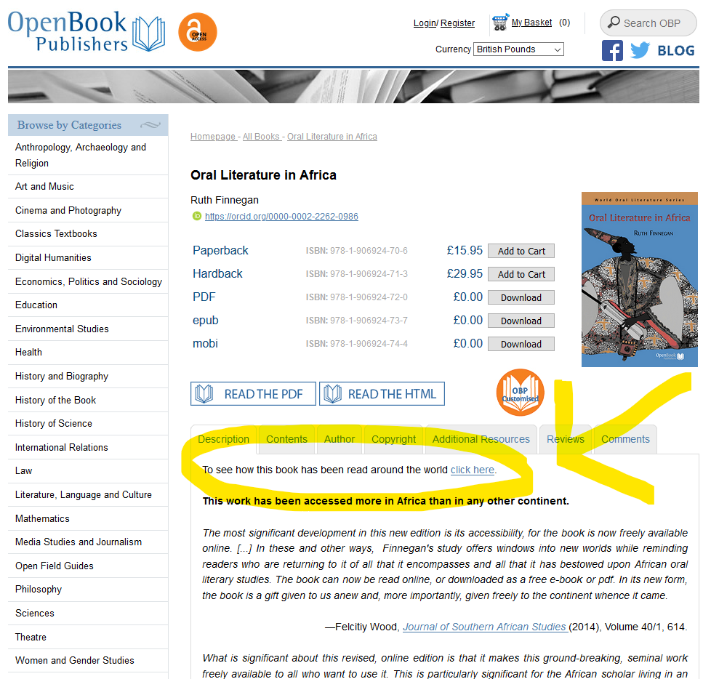
Readership statistics!

Slide 15
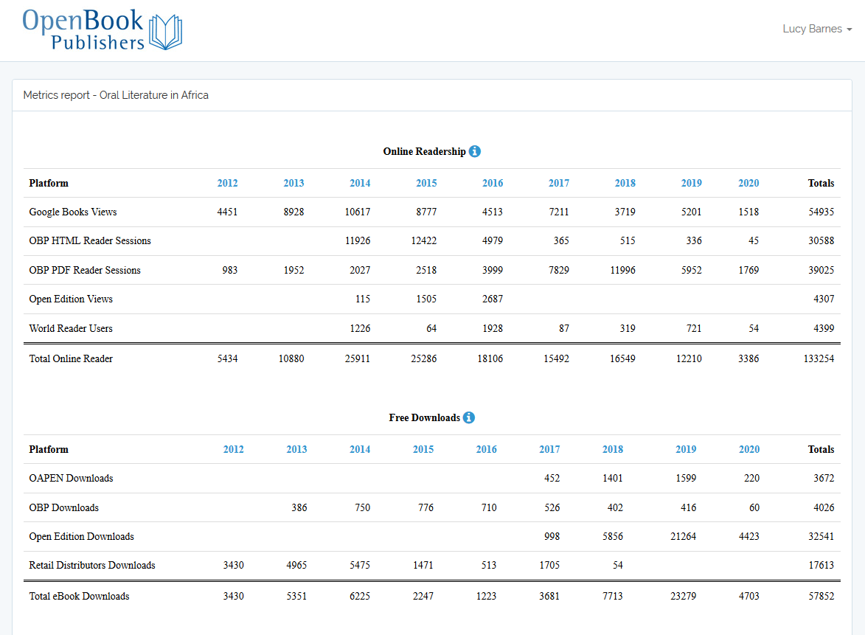
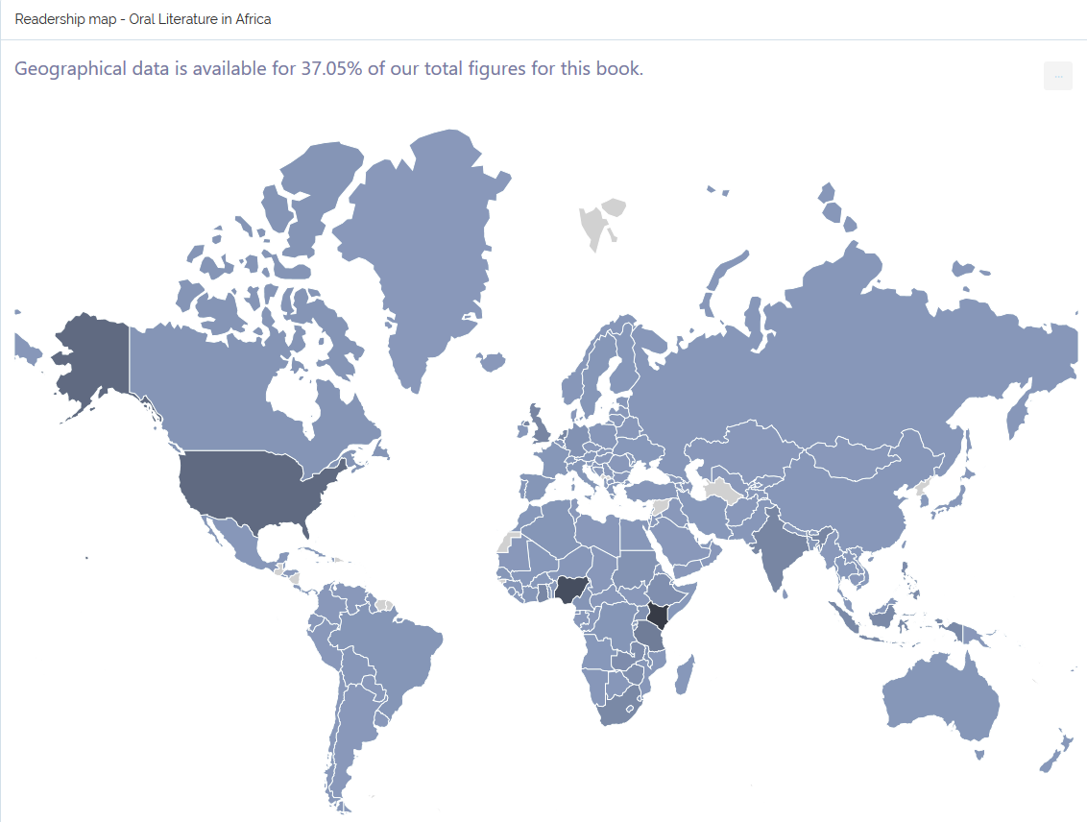

Slide 16
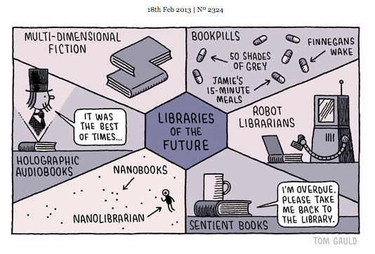
The future of OA books

Slide 17






A consortium of five Open Access book publishers
Not-for-profit & academic-led
Developing collaborative approaches to OA book publishing
Key partners in the £2.2 million COPIM project
(Community-led Open Publication Infrastructures for Monographs)
https://scholarled.org

Slide 18

Community-led Open Publication Infrastructures for Monographs
Building community-controlled, open systems and infrastructures to develop open access book publishing
Making it easier to publish, disseminate and discover Open Access books

Slide 19

We want to hear from you!
How do you discover Open Access books?
How do you integrate them into your catalogues?
How do you publish or disseminate Open Access books?
Please fill in our questionnaire! https://cambridge.eu.qualtrics.com/jfe/form/SV_cT3pPWOZPXNxOxT
Photo by Kyle Smith on Unsplash

Slide 20

Thanks for listening!
Any questions…?
lucy@openbookpublishers.com
www.openbookpublishers.com
@openbookpublish
https://copim.pubpub.org/
@COPIMproject
https://scholarled.org
@scholarled

