Slide 1
CUFTS Resources Comparison Tool
Jevgenija Sevcova
Lithuanian Research Library Conosrtium

Slide 2
What is CUFTS?
CUFTS is a free, open source OpenURL link resolver and electronic resource management system
CUFTS modules:
CUFTS: Open Source Serials Management – allows library to manage information about its e-resources collections. System includes tools such as Resource comparision and Journal Search
GODOT: Open Source Link Resolving – provides links to library’s full text collections using CUFTS knowledge base
Open Knowledgebase – currently contains over 500 resources.
http://www.lib.sfu.ca/about/initiatives/researcher

Slide 3
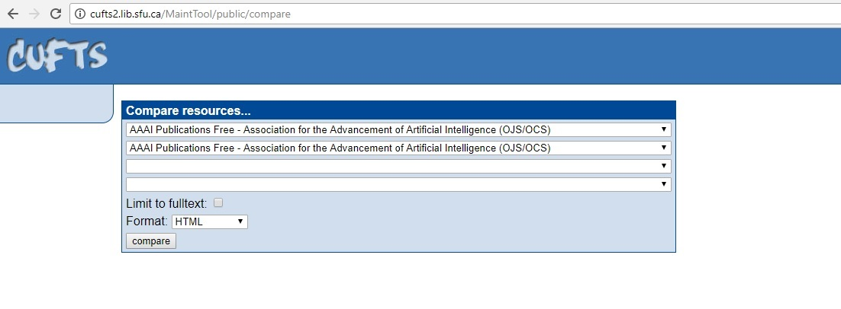
Resource comparision
Link to the tool http://cufts2.lib.sfu.ca/MaintTool/public/compare

Slide 4
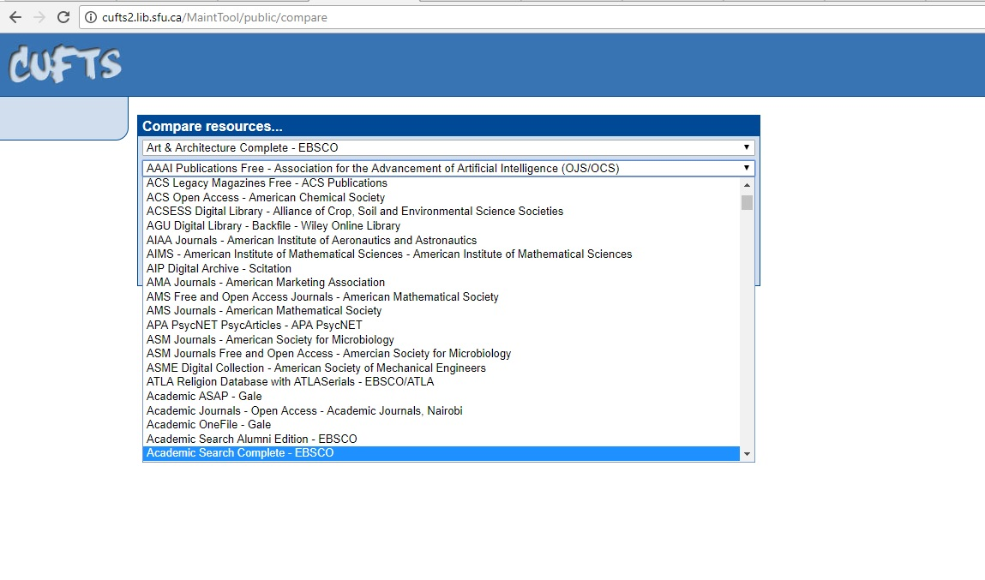
Step1: select resources

Slide 5
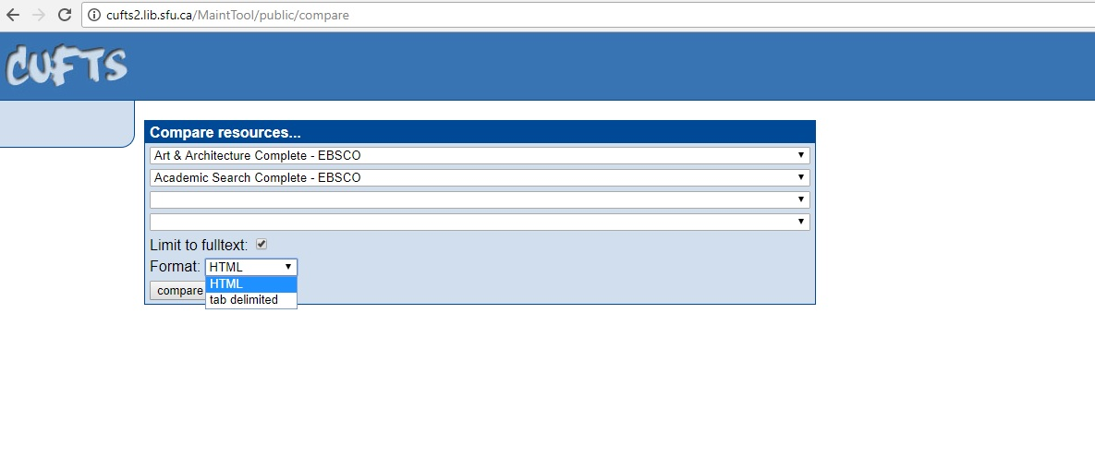
Step 2: limit to full text and select format of report

Slide 6
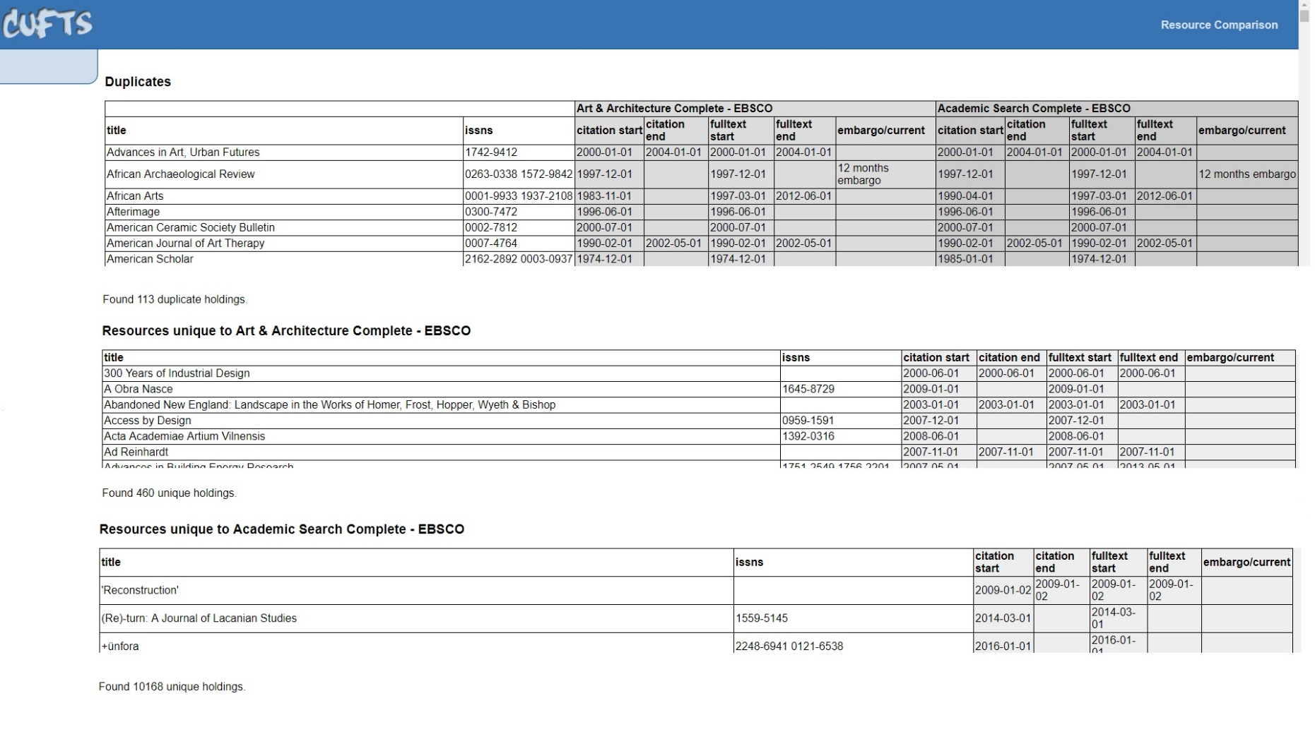
Step 3: evaluate report of overlapping

Slide 7
CUFTS Resources Comparison Tool
Advantages
Disadvantages
Free
Easy to use
Clear reports
Contains all most popular resources
It is possible to compare only up to 4 resources in one go
Sometime names of the resources are not accurate
Difficult to compare separate collections

Slide 8
Thank you!
Questions?
jevgenija.sevcova@lnb.lt
jevgenija.sevcova@eifl.net

